Slide 1
Housing Price Predictor for King County, WA
FlatIron Data science bootcamp
Module 1 Final project

Slide 2
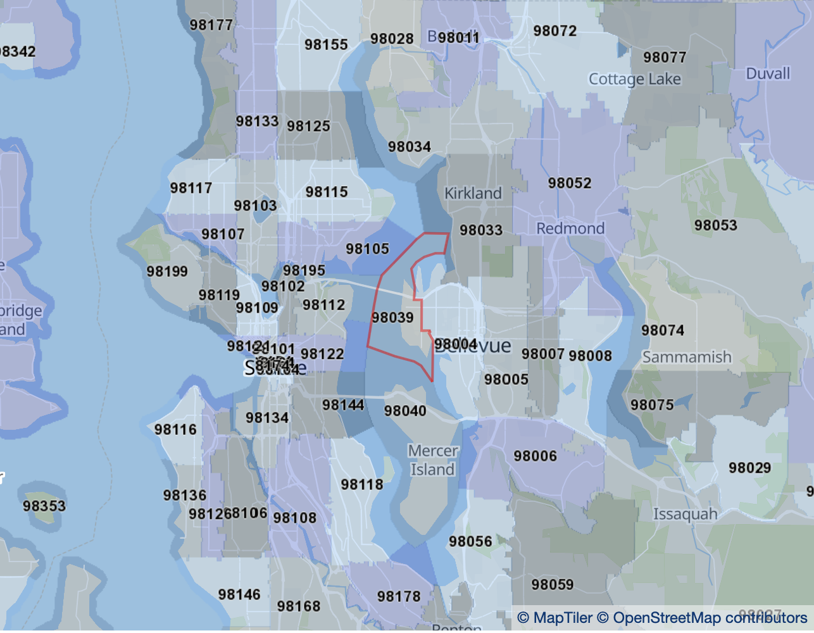
Notes:
Problem: What factors influence home sale price in King County, WA. Wide range of residential areas (seattle to the west and national forests to the east). Founded in 1852, historical value homes.
Creating a model to predict sale price has great business value to both sellers and buyer. Independent realtors could use the model to best direct their clients on how to price their house for sale, how much to offer for a house on the market, what additions to make to a house to increase its sale price in the future

Slide 3
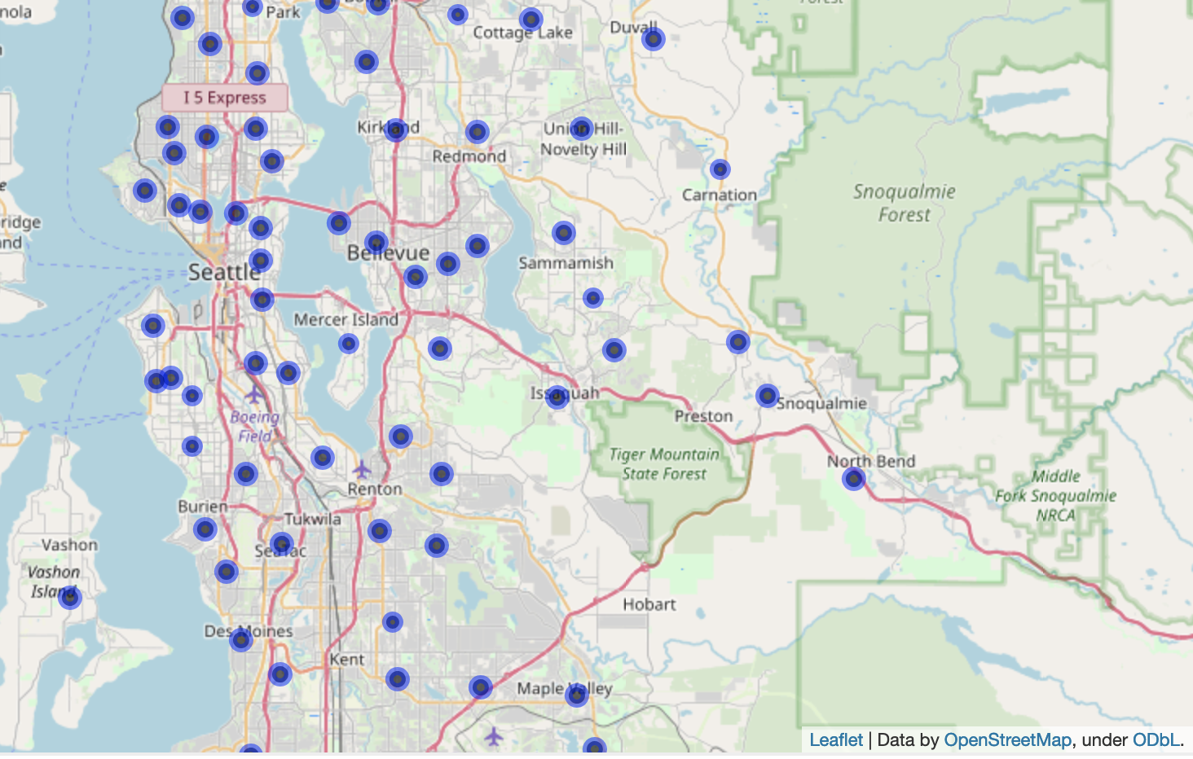
Notes:
Analyze data from over 20,000 homes sold between may 2014 and may 2015 taking into account features concerning both house attributes and location

Slide 4
Notes:
Early models indicate that location plays the biggest role in predicting sale price, however square footage and water views factor into the model
Currently the model is predicting sale price with roughly 70% accuracy, with room for improvement

Slide 5
Notes:
Early models indicate that location plays the biggest role in predicting sale price, however square footage and water views factor into the model
Currently the model is predicting sale price with roughly 70% accuracy, with room for improvement

Slide 7
Future Work
Refine model features
Increase accuracy

